Slide 1
Australian Council of Deans of Health Sciences
Campaign Evaluation Report
August 2024

Slide 2
Agenda
03
04
06
08
20
22
Campaign Components
Media Release
Results
Media campaign overview
Case Study Analysis
Campaign lessons and recommendations

Slide 3
Campaign components
Draft and edit media release
Strategic advice on story timing for best impact
Targeted pitching
Seeking new case studies in areas outside of Melbourne
Both targeted and broad distribution of the media release to relevant media outlets. Focused in areas of Health, Education, and Policy.

Slide 4
Media Release

Slide 5
Media Release

Slide 6
Results

Slide 7
Results
Reached a potential audience of 3.42 million people
ABC News had the largest potential reach of 1,126,000 viewers
The most frequently mentioned keywords
Students
Support
Challenges
Teaching
Health

Slide 8
Media campaign overview

Slide 9
Media results snapshot

Slide 10
Audience reach
3,427,600 is the cumulative potential audience reach.
+866,100 compared to last campaign

Slide 11
Total media coverage
21 total media clips, including syndications across a range of print, online, and radio coverage.
3 x Radio:
3 x Metro
16 X Online:
7 x National
2 x Regional
2 x Metro
2 x State
3 x Trade
2 x Print:
2 x Metro
Notes:
The theme of metro areas picking up coverage - Opportunity for better digested state-by-state reports might be useful for all

Slide 12
Overview: Radio coverage secured
3 radio mentions. Including Syndications
56,600 potential audience reach

Slide 13
Key radio coverage
ABC Hobart – Breakfast with Ryk Goddard
21 August 2024
Placement poverty doesn't discriminate based on the course you’re studying so its something that needs to be addressed more broadly.

Slide 14
Key radio coverage
The Daily – 2SER FM (Sydney)
26th August 2024
If you want to try and influence government policy, If you want to try and change the society that we live in, Don’t sit on your hands, get out there, have a conversation, write a letter, get involved and advocate with our decision makers to try and change the policy in place

Slide 15
Overview: Online/ print coverage secured
16 online/ print mentions including syndications.
3,367,000 potential audience reach.
Online Media breakdown:
7 x National
2 x Regional
2 x Metro
2 x State
3 x Trade
Print Media breakdown:
2 x Metro

Slide 16
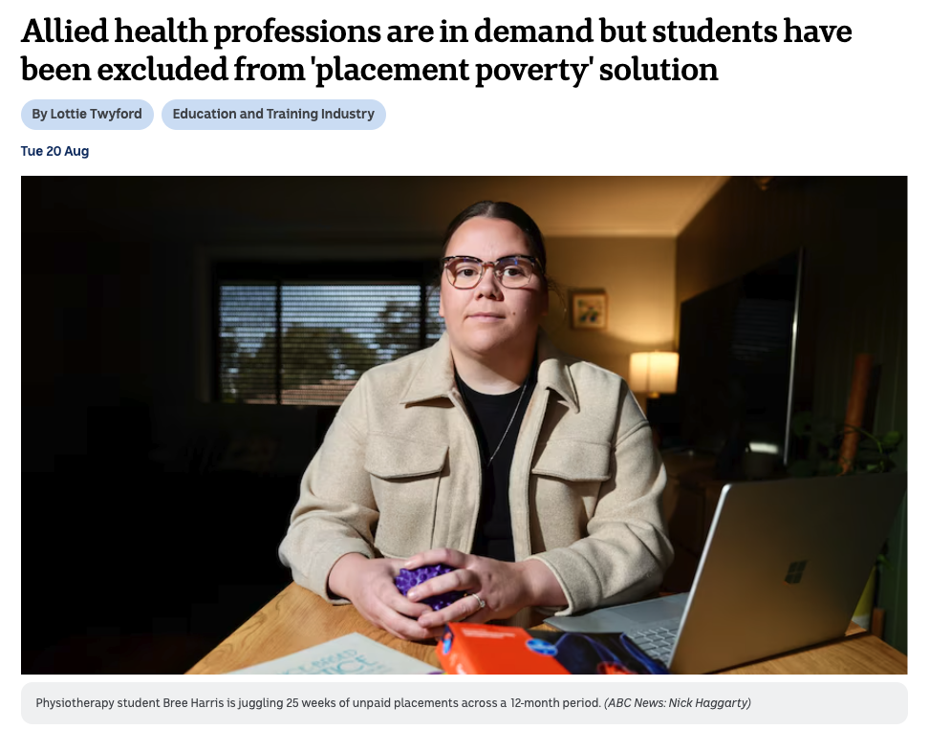
Key online/ print coverage
ABC
20th August 2024
1,126,000 potential audience reach
After the difficulty of full-time placements, Ms Hely has turned to completing hers on a part-time basis to "stay afloat".
That arrangement means she can do three days a week at placement and two days a week at her paid job.
But even with that in place, Ms Hely still finds placement a "disheartening" time with the worry of her finances always in the back of her mind — especially with the prospect of a HECS debt to start paying off once she graduates next year.

Slide 17
Key online/ print coverage
Herald Sun
21st August 2024
559,000 potential audience reach
Syndicated across 10 outlets:
Townsville Bulletin
The Courier Mail
The Advertiser
NT News
Mercury
Herald Sun
Gold Coast Bulletin
Geelong Advertiser
Cairns Post
First year student Ruby Conheady is also studying radiography and medical imaging at Monash University and is required to do more than 2000 hours of unpaid placement over four years.
“We don’t get to choose where we do our placements … sometimes I find myself paying two rents because I have to relocate (from Melbourne) for some placements,” she said.
Ms Conheady works two jobs to make ends meet, but said most of her income is saved up so she can pay for the necessities while she is on placement.

Slide 18
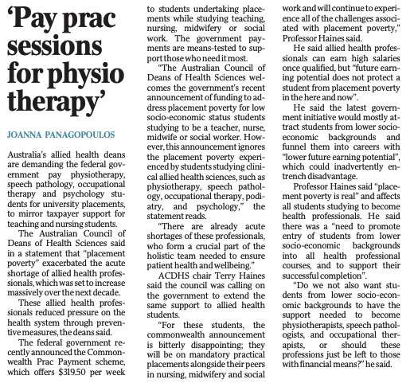
Key online/ print coverage
The Australian
20th August 2024
410,000 potential audience reach
Australia’s allied health deans are demanding the federal government pay physiotherapy, speech pathology, occupational therapy and psychology students for university placements, to mirror taxpayer support for teaching and nursing students.
The Australian Council of Deans of Health Sciences said in a statement that “placement poverty” exacerbated the acute shortage of allied health professionals, which was set to increase massively over the next decade.
These allied health professionals reduced pressure on the health system through preventive measures, the deans said.

Slide 19
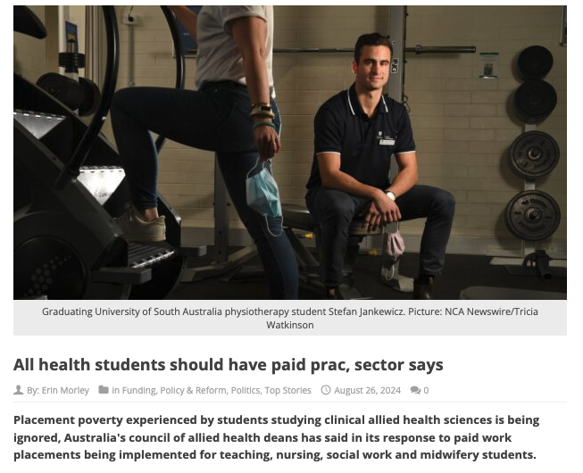
Key online/ print coverage
Campus Review
26 August 2024
4,000 potential audience reach
Placement poverty experienced by students studying clinical allied health sciences is being ignored, Australia's council of allied health deans has said in its response to paid work placements being implemented for teaching, nursing, social work and midwifery students.

Slide 20
Case Study Analysis

Slide 21
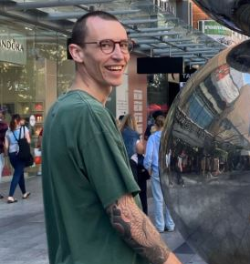
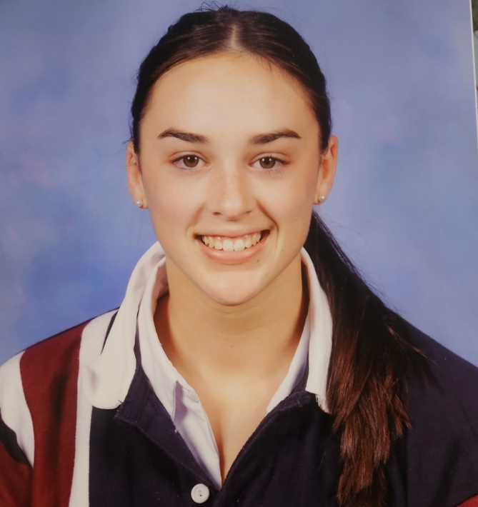
Case study appearances
Case Study: Thomas Street
Outlet: Herald Sun
Appearance:
“These students will be the future of healthcare. Ensuring they reach the end of their degree is imperative to Australian health,”
Case Study: Viviana Gonzalez
Outlet: Daily Strait
Appearance:
Without family support in Australia, she struggles to balance her responsibilities as a parent with her studies and work. The additional costs of tolls and parking at hospitals where she does her placements only add to her financial burden.
Case Study: Ruby Conheady
Outlet: Herald Sun
Appearance:
“The government needs to think about the rest of the health care system because it can’t function without us.”
Case Study: Daniel Truong
Outlet: Daily Strait
Appearance:
However, during placements, Daniel is unable to work, losing crucial income needed to sustain himself. The financial stress, coupled with the demands of his studies, has negatively impacted his performance in university assessments and coursework.

Slide 22
Campaign lessons and recommendations

Slide 23
Recommendations
A greater array of case studies available nationally. This will allow for the story to be picked up in areas outside of Melbourne, as there was a wider variety of media interest in other metro areas across Australia.

Slide 24
Thank you!

